Slide 1
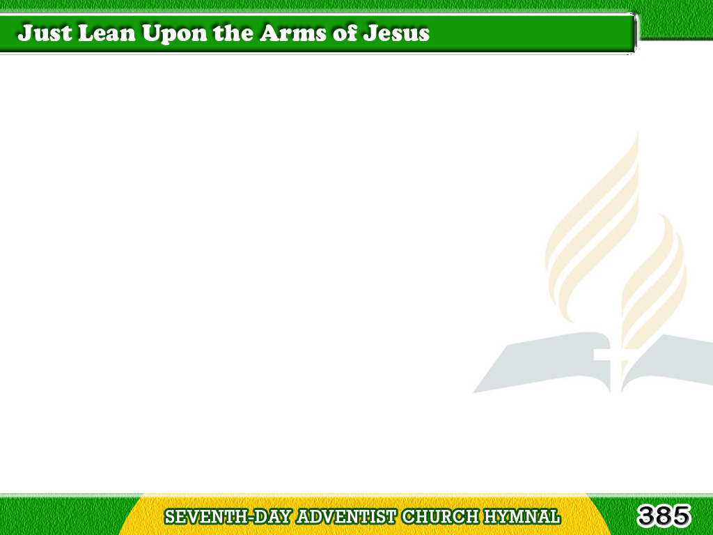
1/4
Just lean upon the arms of Jesus,
He’ll help you along,
help you along;
If you will trust His love unfailing,
He’ll fill your heart with song.
Tagalog
Version

Slide 2
1/4
Chorus
Lean on His arms,
trusting in His love;
Lean on His arms
all His mercies prove;
Tagalog
Version

Slide 3
1/4
Chorus
Lean on His arms,
looking home above,
Just lean on the Saviour’s arms!
Tagalog
Version

Slide 4
2/4
Just lean upon
the arms of Jesus,
He’ll brighten the way,
brighten the way
Tagalog
Version

Slide 5
2/4
Just follow gladly
where He leadeth,
His gentle voice obey.
Tagalog
Version

Slide 6
2/4
Chorus
Lean on His arms,
trusting in His love;
Lean on His arms
all His mercies prove;
Tagalog
Version

Slide 7
2/4
Chorus
Lean on His arms,
looking home above,
Just lean on the Saviour’s arms!
Tagalog
Version

Slide 8
3/4
Just lean upon
the arms of Jesus,
O bring ev’ry care,
bring ev’ry care!
Tagalog
Version

Slide 9
3/4
The burden that has
seemed so heavy,
Take to the Lord in pray’r.
Tagalog
Version

Slide 10
3/4
Chorus
Lean on His arms,
trusting in His love;
Lean on His arms
all His mercies prove;
Tagalog
Version

Slide 11
3/4
Chorus
Lean on His arms,
looking home above,
Just lean on the Saviour’s arms!
Tagalog
Version

Slide 12
4/4
Just lean upon
the arms of Jesus,
Then leave all to Him,
leave all to Him;
Tagalog
Version

Slide 13
4/4
His heart is full
of love and mercy,
His eyes are never dim.
Tagalog
Version

Slide 14
4/4
Chorus
Lean on His arms,
trusting in His love;
Lean on His arms
all His mercies prove;
Tagalog
Version

Slide 15
4/4
Chorus
Lean on His arms,
looking home above,
Just lean on the Saviour’s arms!
Tagalog
Version

